Slide 1

RTAC VII
4th Quarterly Meeting
April 25, 2023
Zoom

Slide 2

Chairman
Duane Montgomery
RTAC VII
Welcome to everyone
Minutes posted on the web page

Slide 3

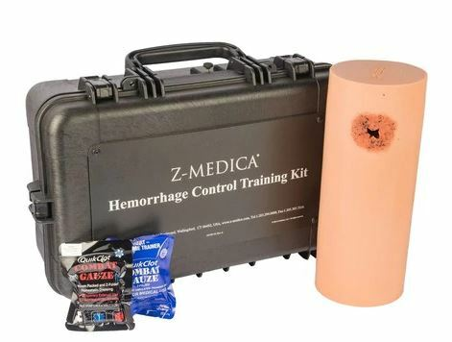
RTAC Coordinator
Brian Dorriety
RTAC VII
STB Training
Trained 6 new instructors for Columbus Fire and EMS
Taught STB – 28 students CFEMS AEMT Students
5-STB trainer kits are available for use, get with Brian, Mary, or Duane and check them out.
Application period May 1st – 31st

Slide 4
American College of Surgeons (ACS) Rural Focused Georgia Consult was back in January. Duane and I attend the 2-day conference. It seems like the entire State is having a lot of the same issues. Lack of funds, staffing. Liz has the results on her desk and will be sending out the recommendations soon.
Possibly adding a Level 4 Trauma center: Martin Army Community Hospital.
FY24 the GTC is going to a PBP Metric system: they will hold RTAC coordinators, GEMSA, AVLS, The Trauma Foundation and any other contractors to a PBP standard or the GTC will deduct up to 6% from their payouts.

Slide 5
RTAC’s are now using a web page so to post events, meeting and any upcoming training. The official domain is
rtac.gtcnc.org

Slide 6

Chairman
Duane Montgomery
Budget / Treasurer Report
FY23 budget:
Trauma Centers - 1.1 Million
EMS - $290, 370.00.

Slide 7
RTAC Coordinator
Brian Dorriety
Trauma Plan
RTAC Trauma Plan was last revised January 17, 2023.
Changes on pages 5, 22, 34, 35, 36

Slide 8

RTAC VII
Hospital /Trauma Facility
Jack Rodgers, RN, ED Director
Ashley Forsythe, RN, ED Manager

Slide 9
Vice-chair
Mary Bizilia, RN,
Trauma Program Manager
RTAC VII
Education/Training
February 27, 28 Macon County completed an ITLS Course with 13- students, 1- Instructor Candidate, 7- instructors
Columbus Technical College EMS program completed AMLS Course with 5 students
Harris County EMS hosted a NREMT Refresher course in March and had 23 students complete the course
Macon County EMS has a grant funded EMT course in progress with 17 students attending
Talbot County EMS has a grant funded EMT course in progress with 12 students attending
Columbus Fire and EMS Academy completed their AEMT online course with 100% pass rate on their psychomotor exam, and cognitive exam. Total of 5 students
Trinity EMS Academy just completed 2 EMT courses with total of 5 students successfully completing the course
Taylor County EMS has a EMT course in progress with 15 students attending
Columbus Technical College has an EMT course in progress with 17 students attending
Community Ambulance Service Training Program completed an AEMT course with 2 students successfully completing the program
EMS Care has completed several EMR programs
Columbus Fire and EMS Academy has a paramedic program in progress with 20 students attending
Columbus Technical College has a paramedic program in progress with 5 students attending
Columbus Technical College EMS program will be hosting a PHTLS Course soon. DTB

Slide 10
PI Coordinator
Kelly Gasser, RN
RTAC VII
Trauma Patient Transport Data
Regional Trauma Log

Slide 11
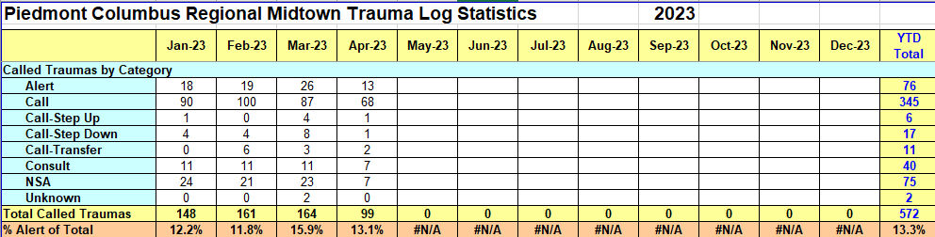
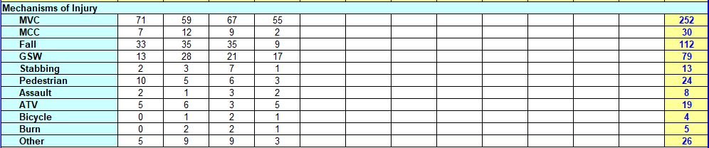
RTAC – 3rd Quarter

Slide 12
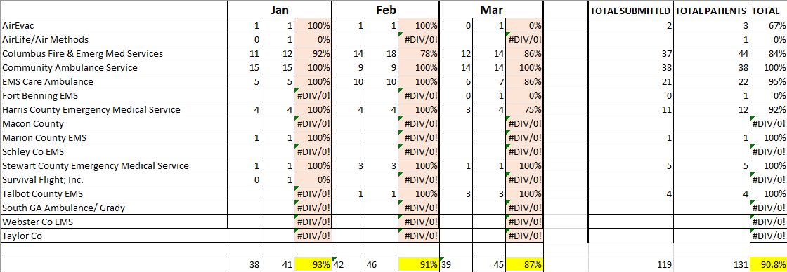
RTAC Pilot – Trip Reports

Slide 13
Injury Prevention and Community Outreach
Purpose
To reduce the number of injuries and deaths through the implementation of effective injury prevention programs.
Mission
In collaboration with community partners, the Region 7 Trauma Injury Prevention Committee will focus on the current mechanisms of trauma related injuries by developing, educating, and implementing strategies that empowers communities to reduce the severity of injuries, disabilities, and deaths due to traumatic events involving individuals of all ages.
Together, we can reduce the occurrence of traumatic injuries!
Vision
A united community passionately working to reduce the occurrence of traumatic injuries in individuals of all ages.

Slide 14
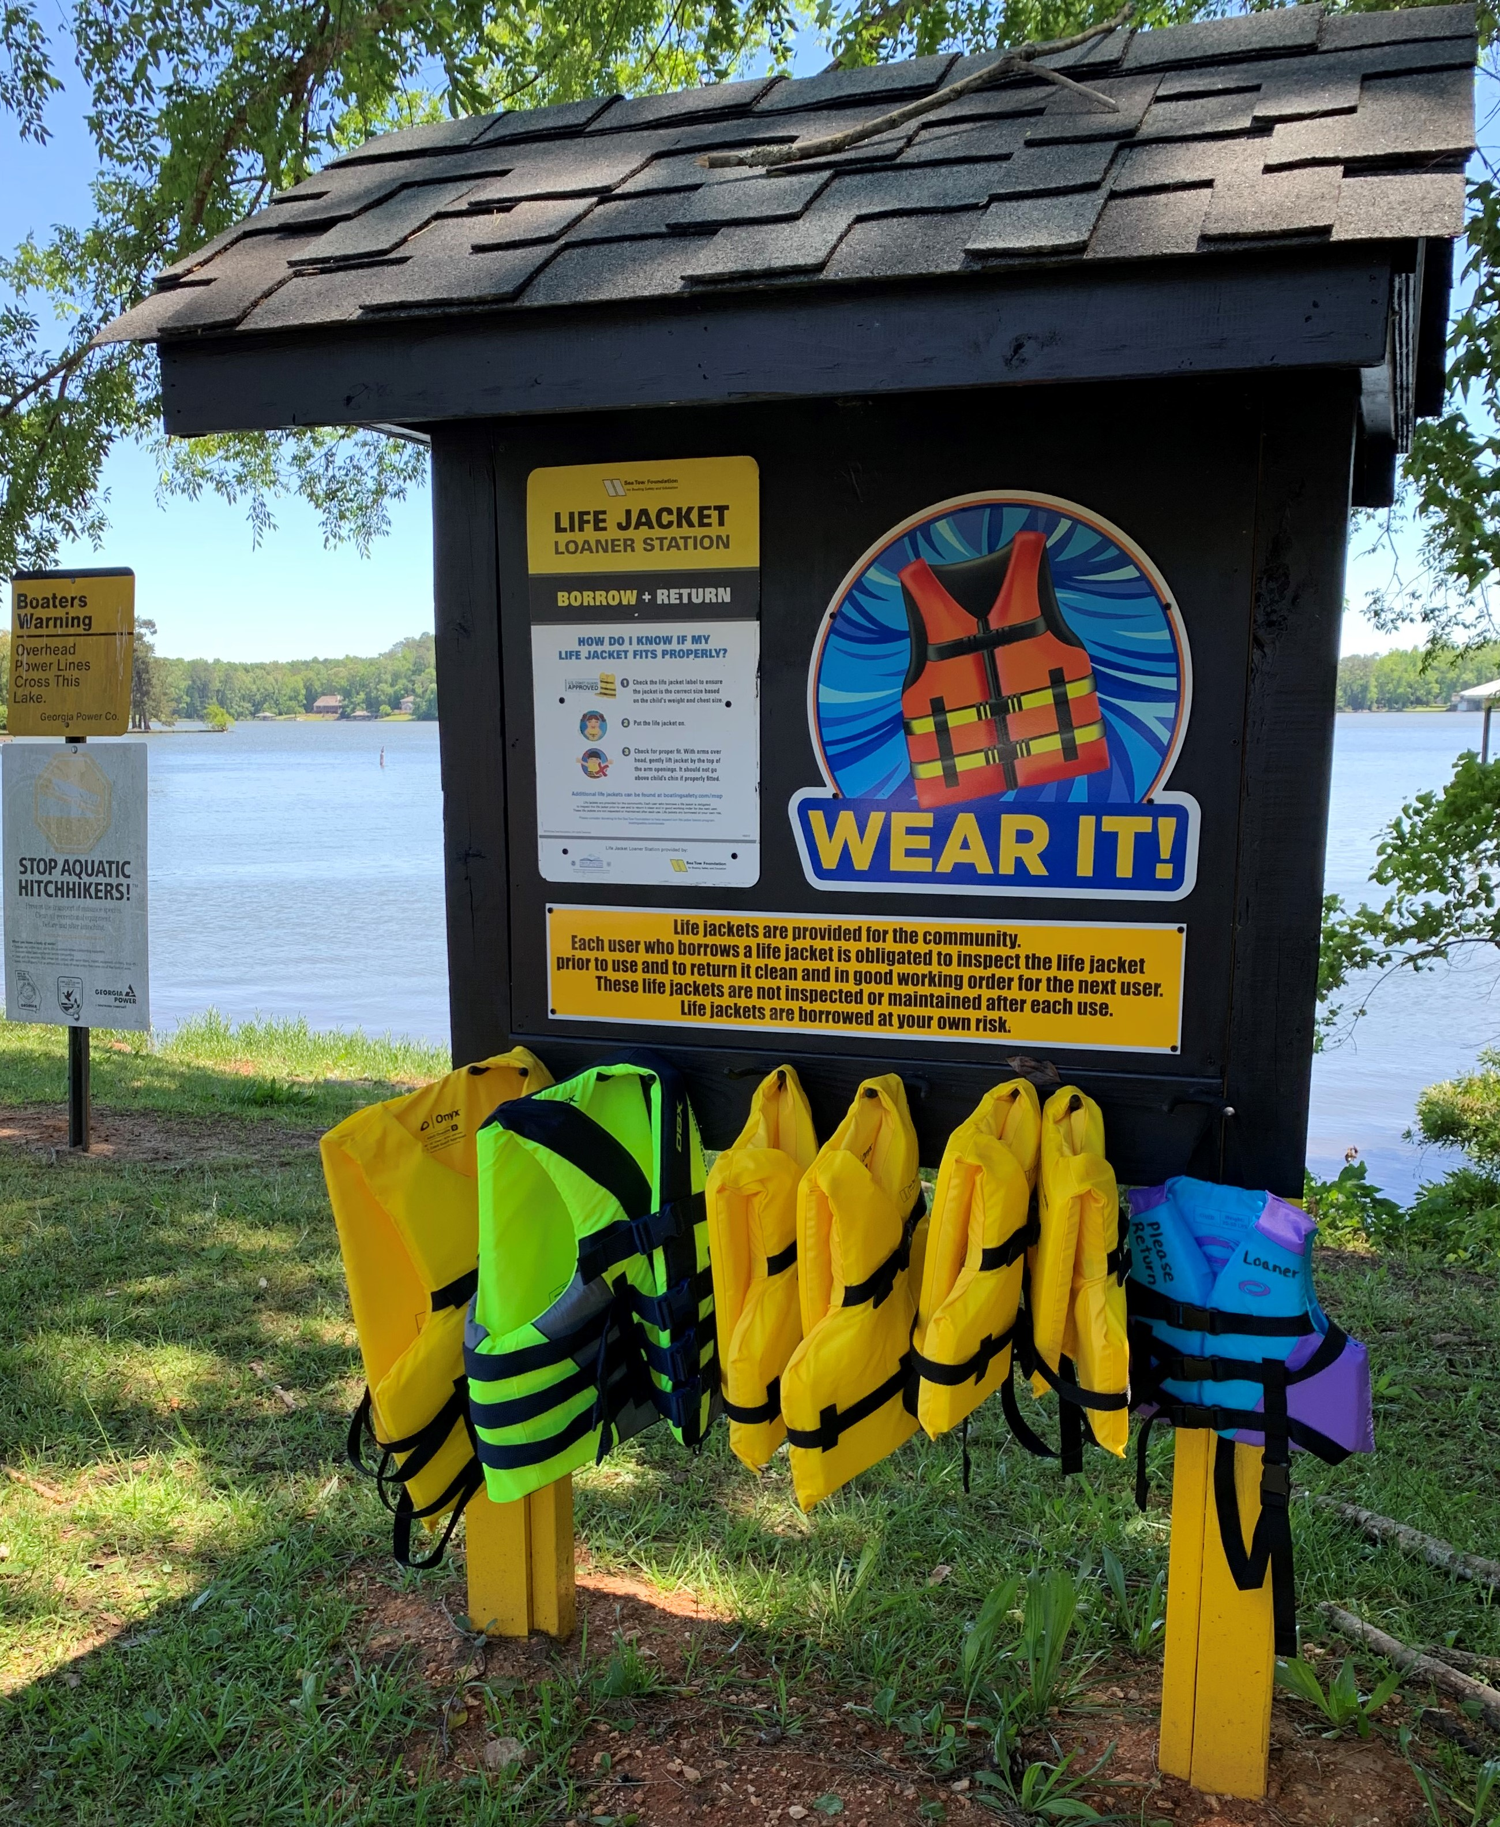
Injury Prevention
ADULT INJURY PREVENTION
FALL PREVENTION Muscogee - Matter of Balance Class has 16 signed up! An all time high for this course!
Tai Chi Classes coming this Fall 2023 in partnership with Area Agency on Aging. $25 for each entire class. Area Agency on Aging may be open to a class in your county! Inquire with them.
MOTOR VEHICLE
Education for adults/teens as part of CPS Safety Courses
PENETRATING INJURIES
AAP Grant for Gun Safety/Lock Boxes was not awarded. Pursing other potential funders.
Online Meeting with Cure Violence - create a strong and collaborative partnership network to effectively address the social and economical inequalities of our city – search for a successful model to replicate - Omaha 360
DROWNING PREVENTION
2023 Life Jacket Loaner Stations Underway! Kick off meeting held on 4/20/23. Life Jackets for 7 loaner stations distributed. No word yet on Sea Tow Grant for 2023.

Slide 15
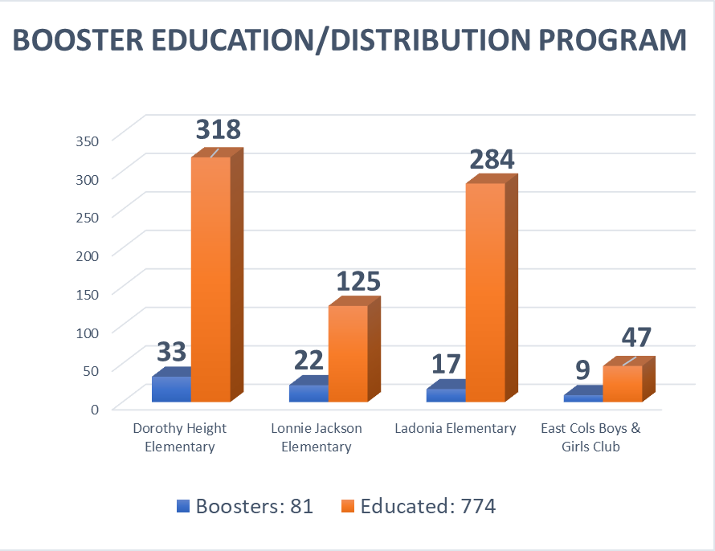
Safe Kids Columbus
Mar 2023 Booster Seat Education & Distribution Event:
Muscogee + Russell County AL

Slide 16
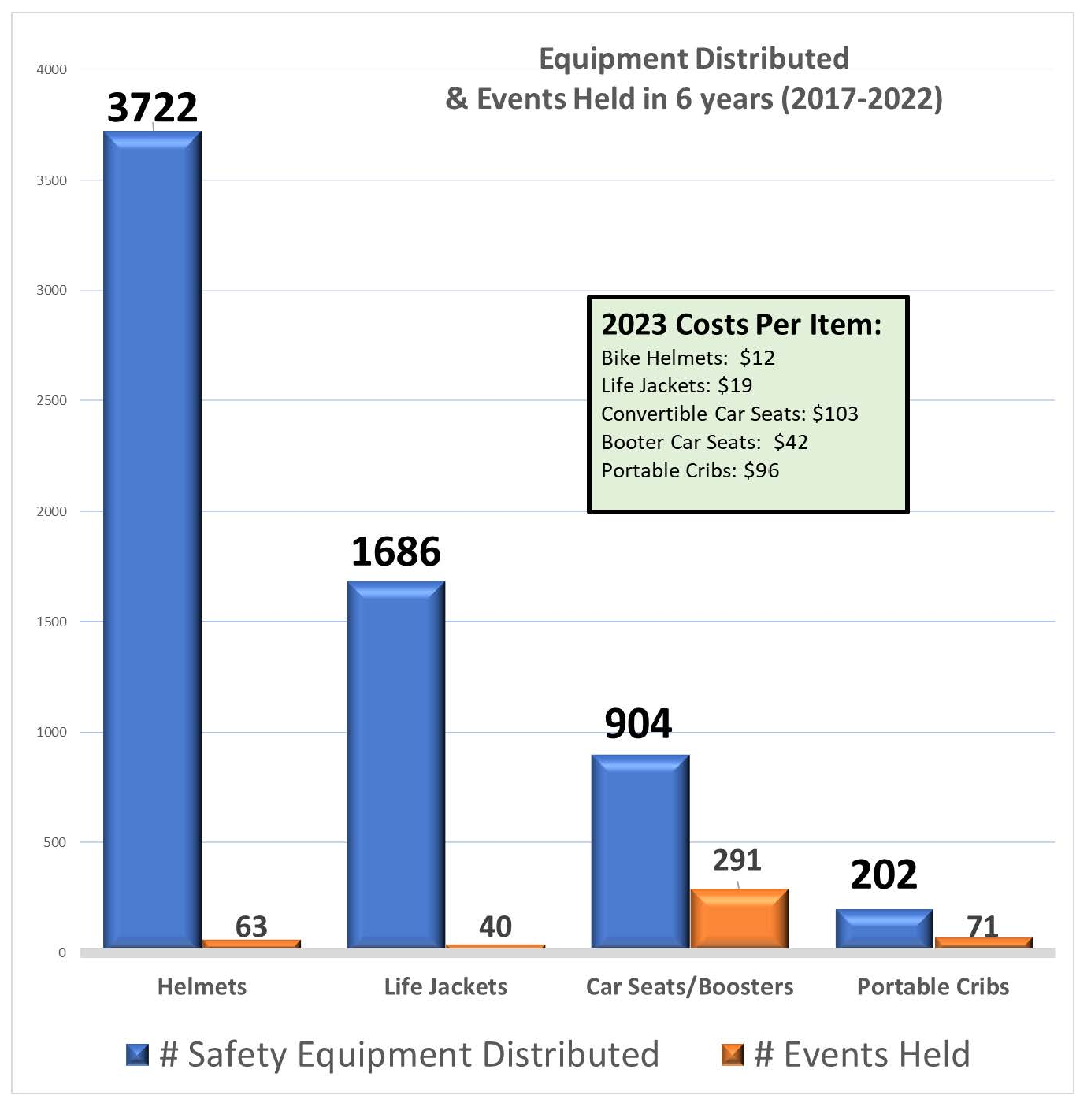

Slide 17

Safe Kids Columbus
River Savvy Kids Event – Free Life Jackets for Kids event, May 13, 2023; Volunteers Needed. Please share with your residents. 700+ Life Jackets donated by: Academy Sports, Cols Parks & Rec, Lake Harding Neighborhood Association.
Safe Sleep Classes – 2023 extended to rural counties in Hospital Region/West Central Health District.
Low Cost Car Seat Classes – Muscogee County, $20 per car seat

Slide 18
Medical Oversight
Dr. Scott Hannay, Trauma Medical Director
RTAC VII
Trauma Committee Reports
Questions or Concerns

Slide 19

Air Medical
RTAC VII
Autumn Lindsey
Charles Couey
Chase Lott
Ricky Bias

Slide 20

OEMS&T
Director- Frank Killebrew
RTAC VII

Slide 21

Pediatrics
Chamaine Bjornson, RN
RTAC VII

Slide 22
Emergency Preparedness
Darrell Enfinger, Georgia Department of Public Health (DPH)
Terry Parish, Piedmont Columbus Regional Midtown
Daryl Feagins, Piedmont Columbus Regional Midtown

Slide 23
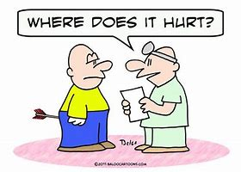



Chairman
Duane Montgomery
RTAC VII
All surrounding hospitals and surrounding EMS agencies in region 7 are encouraged to participate in Region 7 RTAC. Only by active participation will the issues and concerns be adequately addressed.
Why a Trauma System?
+
+
=
RIGHT PATIENT + RIGHT HOSPITAL + RIGHT RESOURCES = OPTIMAL OUTCOME

Slide 24
Chairman
Duane Montgomery
RTAC VII
New Business?

Slide 25

Chairman
Duane Montgomery
RTAC VII

Slide 26
Chairman
Duane Montgomery
RTAC VII
Next Meeting July 26, 2023

Slide 27
Chairman
Duane Montgomery
RTAC VII
Adjourn!

